Slide 1
A Tour of Machine Learning Concepts
Artem Lenskiy
artem.lenskiy@anu.edu.au

Slide 2
Content
What is learning ?
How good is the model ?
How does machine learning work?
Taxonomy of machine learning
Neural networks
Text mining
AirBnB sentiment prediction

Slide 3
What is learning ?
When rats encounter food items with novel look or smell, they will first eat very small amounts.
Animal learning is the alternation of behavior as a result of individual experience. When an organism can perceive and change its behavior, it is said to learn.
food
experience
learning

Slide 4
What is learning ?
Example: Trivial spam detector
Suppose we would like to program a machine that learns how to filter spam e-mails. A naive solution would be similar to the way rats learn how to avoid poisonous baits.
The machine will simply memorize all previous e-mails that had been labeled as spam e-mails by a user.
Database
knowledge
email | label
Dear Sir/Madam, I believe this report meet you in a very good… | spam
Greetings, My name is Mrs. Rachael Tims, 72 yrs old widow. I got… | spam
… | …
experience
email
learning

Slide 5
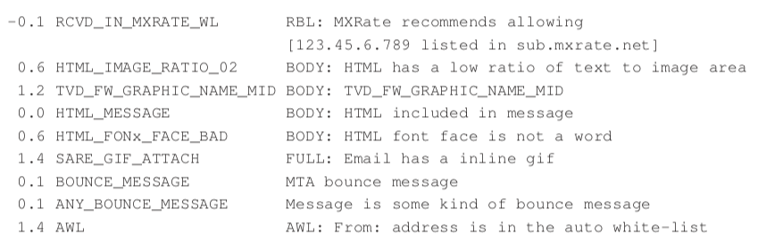

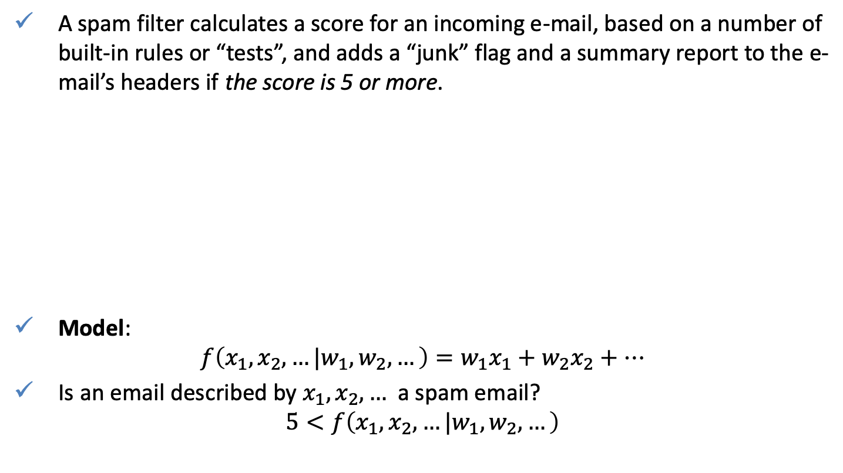



What is learning ?
A spam filter calculates a score for an incoming e-mail, based on a number of built-in rules or “tests”, and adds a “junk” flag and a summary report to the e-mail’s headers if the score is 5 or more.
Model:
$$f\left(x_{1},x_{2},…|w_{1},w_{2},…\right)=w_{1}x_{1}+w_{2}x_{2}+…$$
Is an email described by $x_{1},x_{2},…$ a spam email?
$$5<f\left(x_{1},x_{2},…|w_{1},w_{2},…\right)$$
$$x_{1}$$
$$x_{2}$$
$$x_{3}$$
$$⋮$$

Slide 6
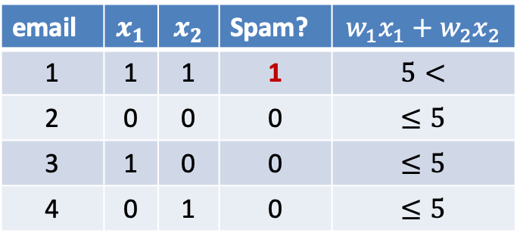
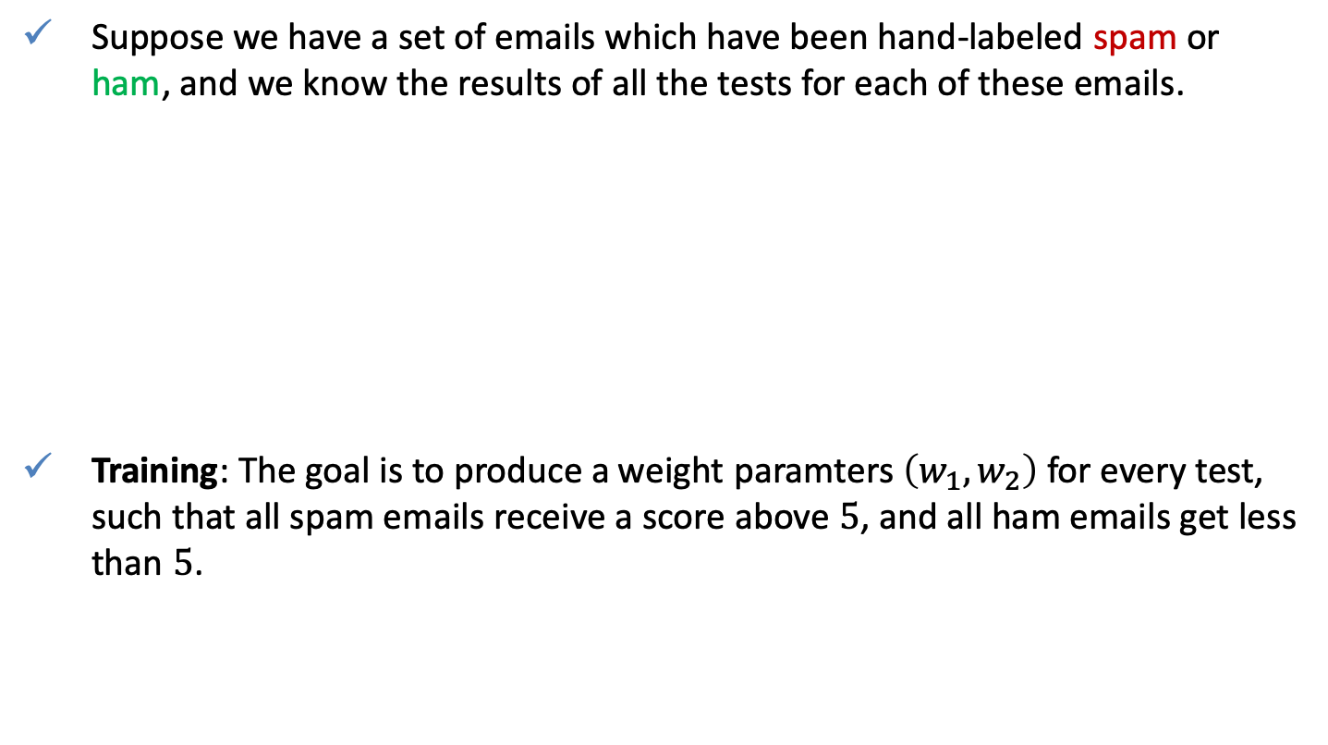
What is learning ?
Suppose we have a set of emails which have been hand-labeled spam or ham, and we know the results of all the tests for each of these emails.
Training: The goal is to produce a weight paramters $\left(w_{1}, w_{2}\right)$ for every test, such that all spam emails receive a score above $5$, and all ham emails get less than $5$.
email | $$x_{1}$$ | $$x_{2}$$ | Spam? | $$w_{1}x_{1}+w_{2}x_{2}$$
1 | 1 | 1 | 1 | $$5<$$
2 | 0 | 0 | 0 | $$≤5$$
3 | 1 | 0 | 0 | $$≤5$$
4 | 0 | 1 | 0 | $$≤5$$

Slide 7




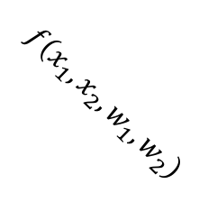


What is learning ?
Training set
Model: $f\left(x_{1},x_{2}|w_{1},w_{2}\right)=w_{1}x_{1}+w_{2}x_{2}$
The learning algorithm consist of finding $\left(w_{1}, w_{2}\right)$ such that the number of mistakes is minimized. The training results in
$$f\left(x_{1},x_{2}|w_{1},w_{2}\right)=4x_{1}+4x_{2}$$
Determine whether emails are spam or ham if their features are given by is
$$x_{1}≡{\left(0.5,0.5\right)}^{T}, x_{2}≡{\left(1.5,1.5\right)}^{T}x_{3}≡{\left(1,0.25\right)}^{T}.$$
$$x_{2}$$
$$5<$$
email | $$x_{1}$$ | $$x_{2}$$ | Spam? | $$4x_{1}+4x_{2}$$
1 | 1 | 1 | 1 | 8
2 | 0 | 0 | 0 | 0
3 | 1 | 0 | 0 | 4
4 | 0 | 1 | 0 | 4
$$≤5$$
$$f\left(x_{1},x_{2},w_{1},w_{2}\right)$$
$$x_{1}$$

Slide 8
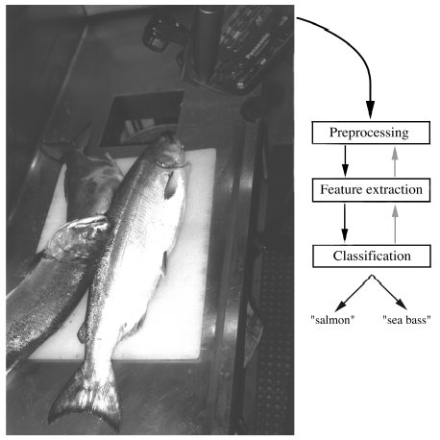
Machine learning: classification
Definition: classification is the problem of identifying to which of a set of categories a new observation belongs.
Suppose a fish-packing plant wants to automate the process of sorting incoming fish on a conveyor belt according to species: sea bass and salmon.
lightness
length
width

Slide 9

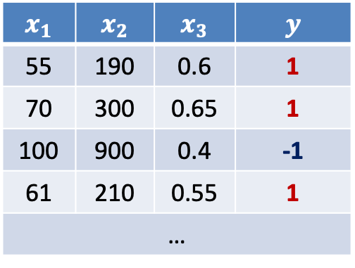


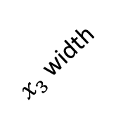

Machine learning: Feature space
The sensors measure certain fish characteristics (features):
  Width - $x_{1}$
  Lenght - $x_{2}$
  Lightness - $x_{3}$
are training (labeled) data
Fish species
$y=\left\{\begin{matrix}\text{sea} \text{bass} & \text{salmon}\end{matrix}\right\}$
The goal is to find a model
$$f\left(x_{1},x_{2},x_{3}\right)→y$$
such that is classified correctly
A feature is an individual measurable property or characteristic of a phenomenon being observed.
$$x_{1}$$ | $$x_{2}$$ | $$x_{3}$$ | $$y$$
55 | 190 | 0.6 | 1
70 | 300 | 0.65 | 1
100 | 900 | 0.4 | -1
61 | 210 | 0.55 | 1
…
$x_{1} l$ightness
Feature space
$$f\left(x_{1},x_{2},x_{3}\right)$$
?
$x_{2}$length
$x_{3}$ width
?

Slide 10

What is learning ?
Machine learning algorithms build a mathematical model of sample data, in order to make predictions or decisions without being explicitly programmed to perform the task.
Model
$$w_{1}x_{1}+w_{2}x_{2}$$
objects
Features
data
output
training data
Features
Learning algorithm
Learning problem

Slide 11

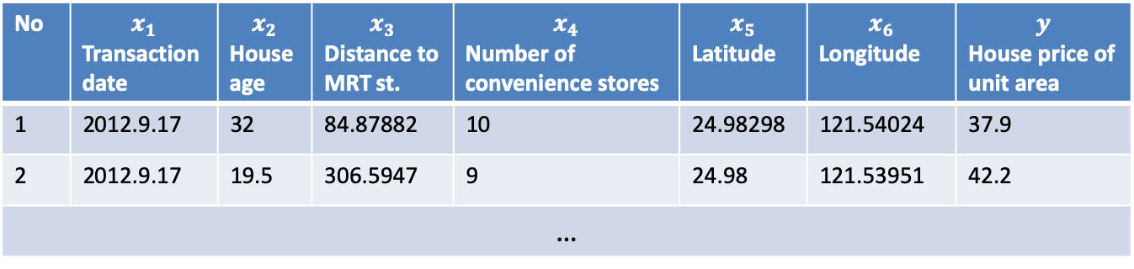
Real estate regression example
Given: The market historical dataset of real estate valuation
http://archive.ics.uci.edu/ml/datasets/Real+estate+valuation+data+set
Goal: to calculate the value of a property
$$f\left(x\right)→price$$
No | $$x_{1}$$ Transaction date | $$x_{2}$$ House age | $$x_{3}$$ Distance to MRT st. | $$x_{4}$$ Number of convenience stores | $$x_{5}$$ Latitude | $$x_{6}$$ Longitude | $$y$$ House price of unit area
1 | 2012.9.17 | 32 | 84.87882 | 10 | 24.98298 | 121.54024 | 37.9
2 | 2012.9.17 | 19.5 | 306.5947 | 9 | 24.98 | 121.53951 | 42.2
…
Definition: regression analysis is a set of procedures used for estimating the relationships among variables. It is widely used for prediction and forecasting.

Slide 12
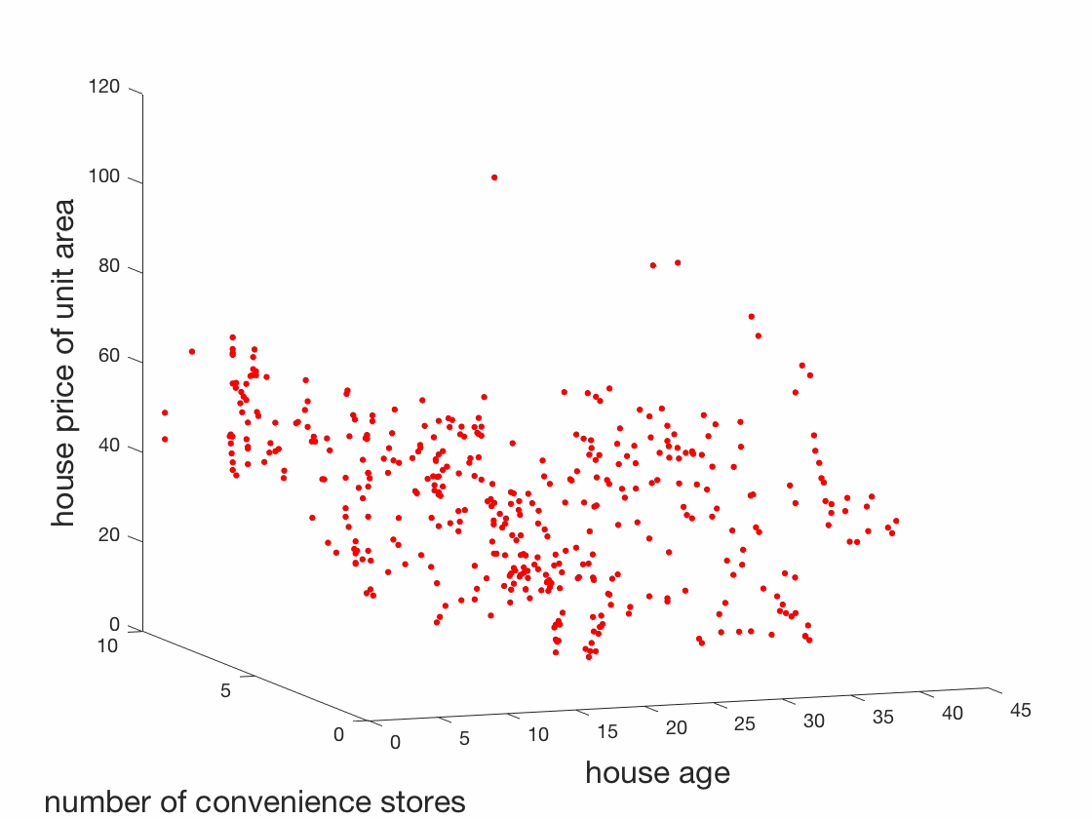
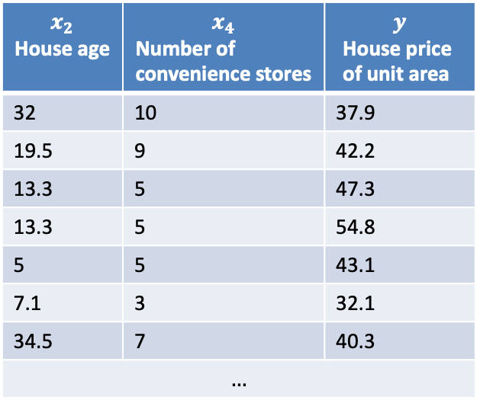

Real estate regression example
For the visualization purpose only the house price and the number of stores are considered as predictors:
$$f\left(x_{2},x_{4}\right)→y$$
$$x_{2}$$ $$\text{House} \text{age}$$ | $$x_{4}$$ $$\text{Number} \text{of} \text{convenience} \text{stores}$$ | $$y$$ $$\text{House} \text{price} \text{of} \text{unit} \text{area}$$
32 | 10 | 37.9
19.5 | 9 | 42.2
13.3 | 5 | 47.3
13.3 | 5 | 54.8
5 | 5 | 43.1
7.1 | 3 | 32.1
34.5 | 7 | 40.3
$$…$$

Slide 13
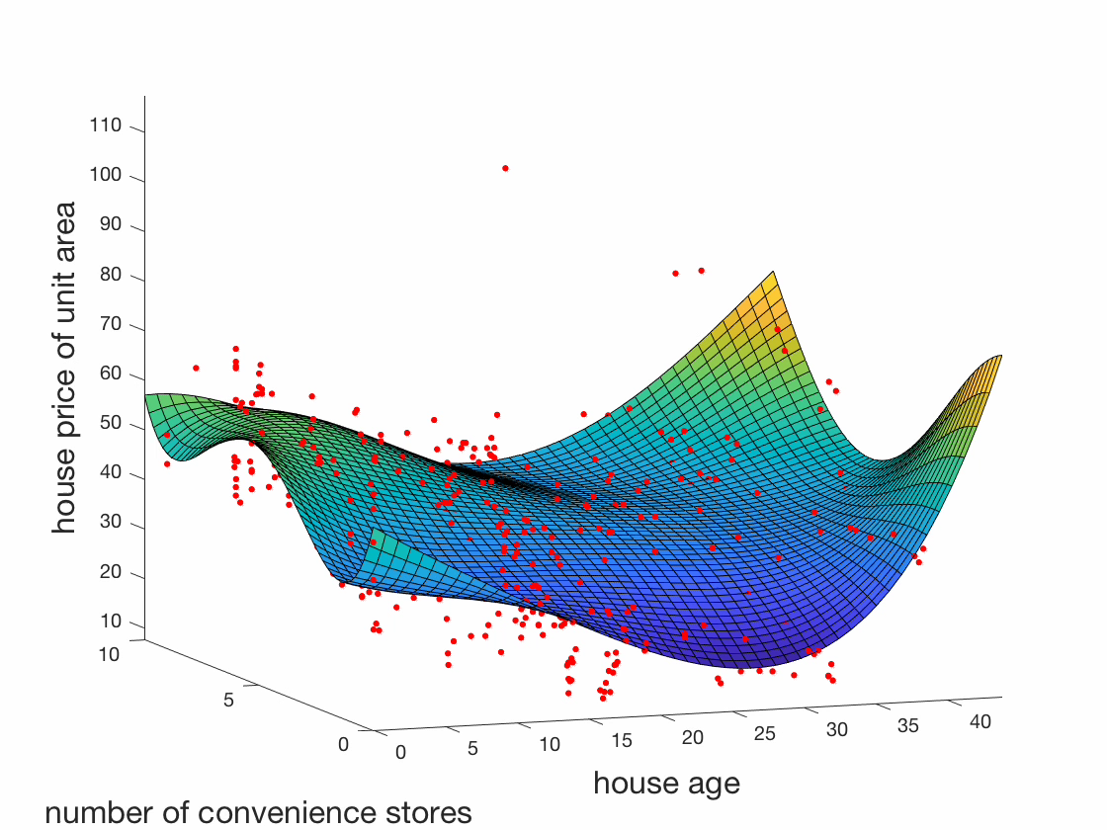
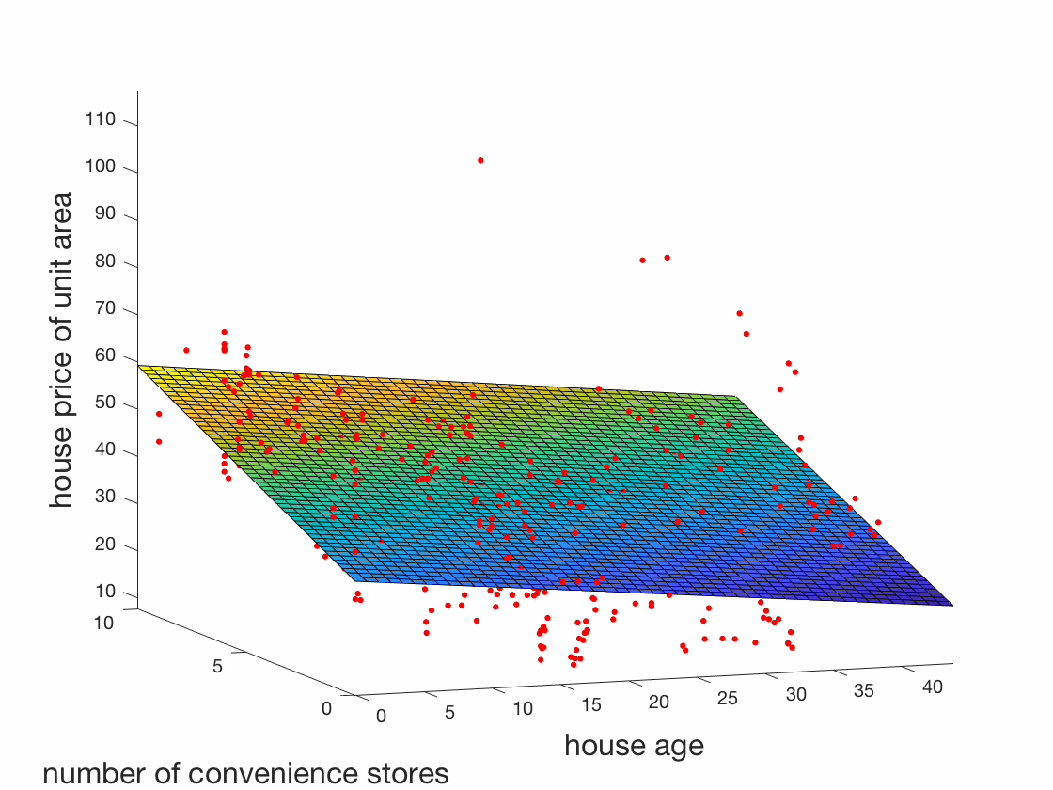

Real estate regression example
Model 1: $f\left(x_{2},x_{4},w\right)=w_{00}+w_{01}x_{2}+w_{10}x_{4}+w_{11}x_{2}x_{4}.$
Model 2: $f\left(x_{2},x_{4},w\right)=w_{00}+w_{01}x_{2}+w_{02}x_{4}^{2}+w_{10}x_{4}+w_{20}x_{4}^{2}+w_{11}x_{2}x_{4}+w_{21}x_{2}^{2}x_{4}+w_{12}x_{2}x_{4}^{2}+w_{22}x_{2}^{2}x_{4}^{2}$

Slide 14
Types of data
Training data set: a set of examples used to learn the parameters.
Validation data set: the fitted model is used to predict the responses for the observations using this dataset.
Test dataset: is used to provide an unbiased evaluation of a final model fit on the training dataset. Usually is not used in training.
Training data
Test data
Validation data

Slide 15
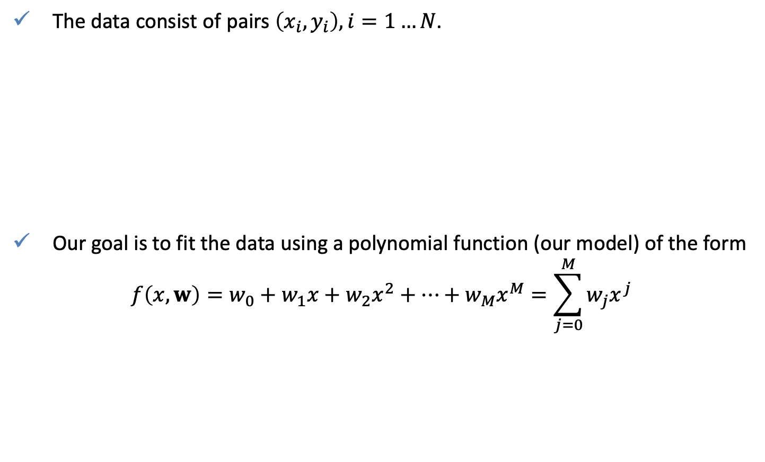
How good is the model?
The data consist of pairs $\left(x_{i},y_{i}\right), i=1…N$.
Our goal is to fit the data using a polynomial function (our model) of the form
$$f\left(x,w\right)=w_{0}+w_{1}x+w_{2}x^{2}+…+w_{M}x^{M}=\sum_{j=0}^{M}{w_{j}x^{j}}$$

Slide 16

How good is the model?
The goal is to minimize an error function that measures the misfit between the function $f(x, w)$, and the training set data points.
$$E\left(w\right)=\frac{1}{N}\sum_{n=1}^{N}{{\left(f\left(x_{n},w\right)−y_{n}\right)}^{2}}→\min{ }$$
The model is too simple The model is too complex
The goal is to generalize (learn) and not to memorize
Mean Square Error
Underfitting
Overfitting
training
training

Slide 17
How good is the model?
Use the validation set to measure the generalization capability of the model
Finally, test on the test set
training
Optimal
validation
training
MSE

Slide 18





How good is the model?
Black curves in the figure below represent a classification model. Which of the models in your onion appropriately separates data into two classes?
$$x_{2}$$
$$x_{2}$$
$$x_{2}$$
$$x_{1}$$
$$x_{1}$$
$$x_{1}$$
(a) | (b) | (c)

Slide 19
How good is the model?
Let’s go back to spam classification example
  Spam emails: 8
  Ham emails: 4
Definition of the Terms
  Positive (ham) : Observation is positive.
  Negative (spam) : Observation is not positive.
  True Positive (TP) : Observation is positive and is predicted to be positive.
  False Negative (FN) : Observation is positive but is predicted negative.
  True Negative (TN) : Observation is negative and is predicted to be negative.
  False Positive (FP) : Observation is negative but is predicted positive.
FN cannot be tolerated but FP can

Slide 20



How good is the model?
Confusion matrix
                Spam(negative) emails: 8
                Ham(positive) emails: 4
                $TP = 1, TN = 5, FP = 1, FN = 3$
Total | Predicted Ham | Predicted Spam
Actual Ham | $$TP$$ | $$FN$$ | $$\frac{TP}{TP+FN}$$
Actual Spam | $$FP$$ | $$TN$$ | $$\frac{TN}{FP+TN}$$
 | $$\frac{TP}{TP+FP}$$ | $$\frac{TN}{FN+TN}$$ | $$\frac{TP+TN}{TP+TN+FN+FP}$$
Total | Predicted Ham | Predicted Spam
Actual Ham | $$1$$ | $$3$$ | $$25\%$$
Actual Spam | $$1$$ | $$7$$ | $$87.5\%$$
 | $$50\%$$ | $$70\%$$ | $$67\%$$
Recall
Recall
Accuracy
Accuracy
Precision
Precision

Slide 21



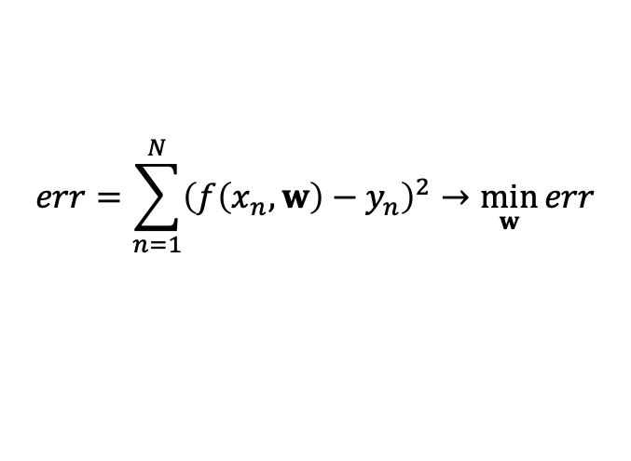





Machine learning as an optimization problem (often approximation)
both tasks approximate an unknown function
$$x_{2}:width$$
$$y:price$$
$$\text{sea} \text{bass}$$
$$f\left(x_{1},x_{2}\right)$$
$$f\left(x\right)$$
$$\text{salmon}$$
$$x_{1}:length$$
$$x:house age$$
$err=dist\left(pred. labels, true labels\right)$ $→\min{ }$
$$err=dist\left(pred. price,true price\right)→\min{ }$$
$$err=\sum_{n=1}^{N}{{\left(f\left(x_{n},w\right)−y_{n}\right)}^{2}}→\min_{w}{err}{ }$$

Slide 22
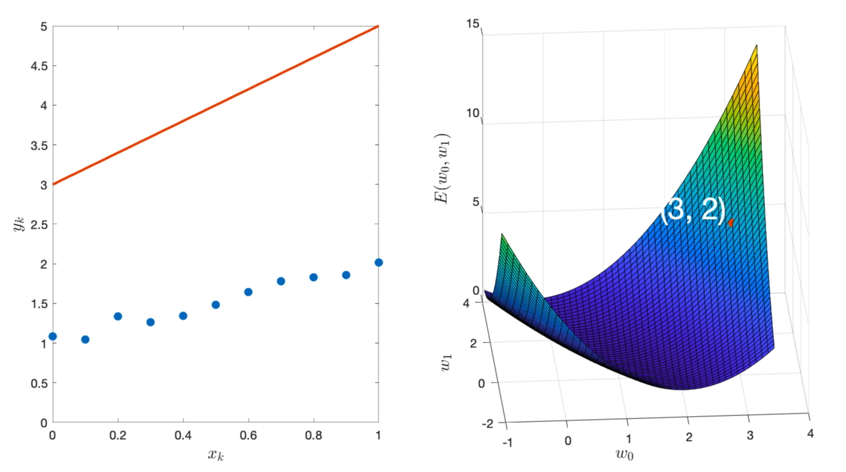
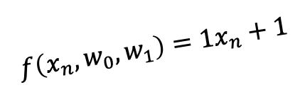
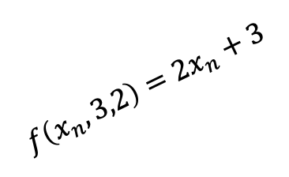
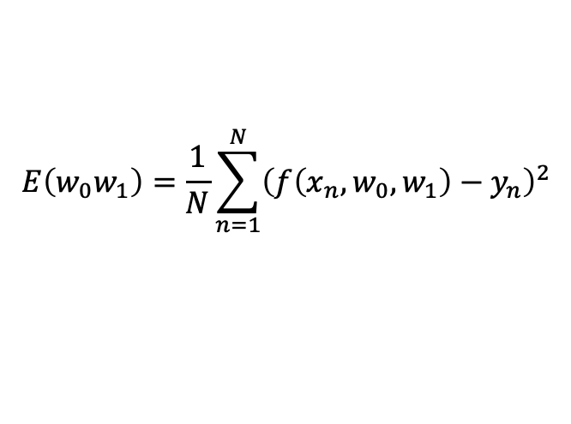
So how does machine learning work?
$$E\left(w_{0}w_{1}\right)=\frac{1}{N}\sum_{n=1}^{N}{{\left(f\left(x_{n},w_{0},w_{1}\right)−y_{n}\right)}^{2}}$$
$$f\left(x_{n},3,2\right)=2x_{n}+3$$
training
$$f\left(x_{n},w_{0},w_{1}\right)=1x_{n}+1$$

Slide 23
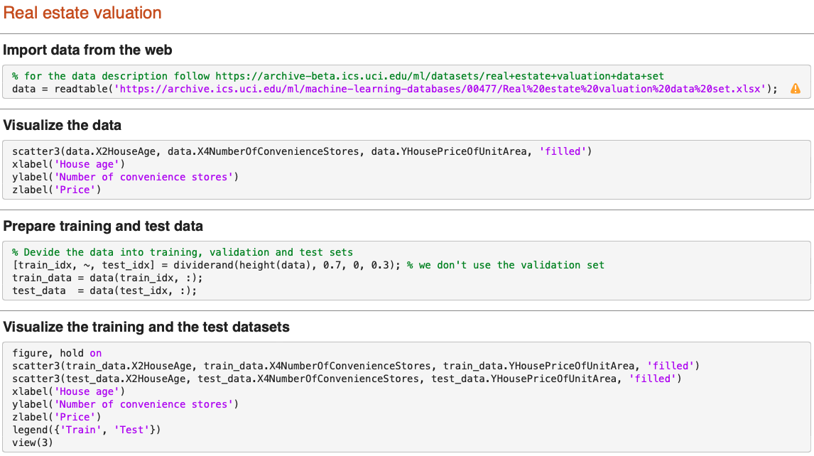
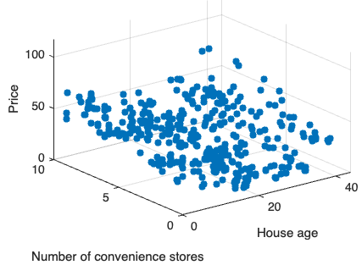
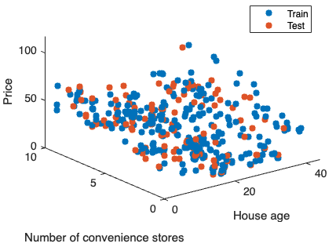
Practice: Predict Property Price using Linear Regression

Slide 24
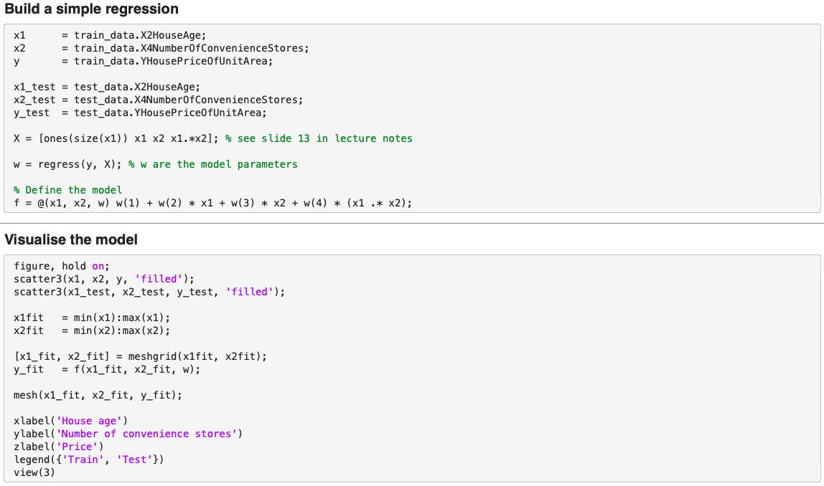
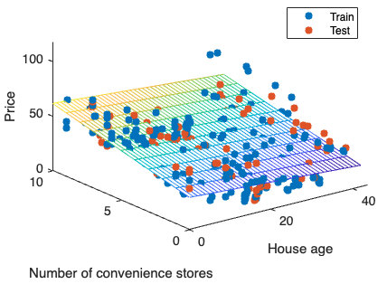
Practice: Predict Property Price using Linear Regression

Slide 25
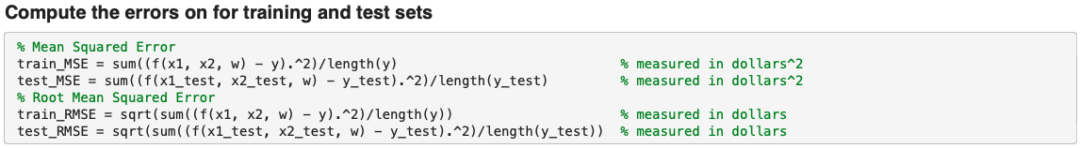
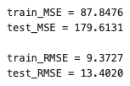
Practice: Predict Property Price using Linear Regression

Slide 26
Key takeaways
Data is more important than models
Machine learning is an optimization problem (often approximation)
Don’t over-fit your model

Slide 27
Q&A
Thank you

